Slide 1

COS 214 Project Plant Nursery Simulator
Abstract Avengers

Slide 2


Our Team
Taskeen Abdoola – u22698681
Sabira Karie – u23591481
Karishma Boodhoo – u23538199
Rene Reddy – u23558572
Kiolin Gounden – u22647300

Slide 3
Project Overview
A digital plant nursery simulates the interaction between greenhouse, staff, and customers to create a realistic, scalable ecosystem.
Greenhouse: Cultivates plants through structured life-cycle care routines (watering, sunlight, fertilizing).
Staff: Manage plant health, handle customer queries, and coordinate stock between greenhouse and sales floor.
Customers: Browse, personalize, and purchase plants with customizable arrangements and dynamic behaviors.
Inventory: Tracks plants as they move from growing to ready-for-sale, ensuring timely replenishment.
Sustainability: Encourages eco-friendly practices and supports long-term growth and variety expansion.
System Design: Built using object-oriented principles and design patterns to ensure flexibility, scalability, and clarity

Slide 4
Functional Requirements – Greenhouse/Garden Area
Plant Care: Executes and undoes watering, fertilizing, and sunlight routines for each plant type.
Plant Lifecycle: Plants transition through states (Seedling → Mature → ReadyForSale) based on care and environment.
Inventory: Traverses plants in stock or growing using iterators.
Stock Management: Supports both single and grouped plant operations (display, count, price).
Plant Creation: Generates new plants via factory selection (Succulent, Flower, Tree).
Auto Updates: Notifies staff and inventory tracker of stock changes.

Slide 5
Functional Requirements – Staff
Plant Care Routines: Staff perform and undo care tasks (watering, pruning, fertilizing).
Issue Escalation: Plant health problems routed through staff hierarchy (junior → specialist).
Inventory Coordination: Mediator syncs stock between greenhouse and sales floor.
Customer Queries: Routed through staff chain based on expertise.
Role Creation: Factory method defines staff roles (gardener, sales assistant, manager).

Slide 6
Functional Requirements – Customers & Sales Floor
Item Browsing: Customers navigate items ready for sale with iterator logic.
Recommendations: Strategy pattern personalizes suggestions based on inputs.
Personalization: Builder assembles arrangements step-by-step (plants, pots, wraps).
Templates: Prototype clones arrangement templates for quick customization.
Layered Add-Ons: Decorator applies gift wraps, notes, or decorative pots.
Order Lifecycle: Orders follow states (Cart → Payment → Completed/Cancelled).
Transactions: Commands handle add/remove/checkout with rollback on failure.
Pricing: Strategy selects pricing model (base, bulk, promo) dynamically.

Slide 7
Non-Functional Requirements
Maintainability: Modular code allows easy addition of plants, staff roles, and routines.
Scalability: Supports dynamic pricing and real-time stock updates without downtime.
Usability: Stepwise, flexible personalization for smooth customer interaction.

Slide 8
Plant Nursery Simulation
How does it work?
Our intelligent simulation autonomously manages greenhouse growth, staff activities, and customer interactions. Each component reacts dynamically to conditions such as plant health, inventory levels, and customer demand to maintain smooth nursery operations..
The simulation tracks:
Plant Health and Growth Stage
Stock Availability (Greenhouse vs Sales Floor)
Staff Workload and Efficiency
Customer Satisfaction
Sales and Revenue Trends
The system runs continuously on its own (plants grow, sales process advances, stock levels update) and accepts user-initiated events—such as requesting assistance, asking for stock replenishment, or specifying a custom arrangement—that influence state transitions and workflow in real time.

Slide 9
Our Interpretation
We interpreted the simulation as a web-based nursery interface rather than a physical walk-in environment because the system’s logic and structure were inherently digital and event-driven. The interactions within our model — such as Add to Cart, and Checkout — reflected user selections typical of an online interface, rather than real-time physical actions between customers and staff. The state transitions (Browsing → CartOpen → PendingPayment → Authorized → Completed) closely mirrored an e-commerce transaction flow, reinforcing this interpretation. Customers were represented as data-driven agents responding through system prompts rather than physically navigating the nursery. Additionally, the use of design patterns like State, Command, and Observer emphasized automated coordination and digital interaction over manual operations. Collectively, these factors aligned our interpretation toward a web-based simulation, where the nursery functions as an interactive digital storefront rather than a traditional walk-in experience.

Slide 10
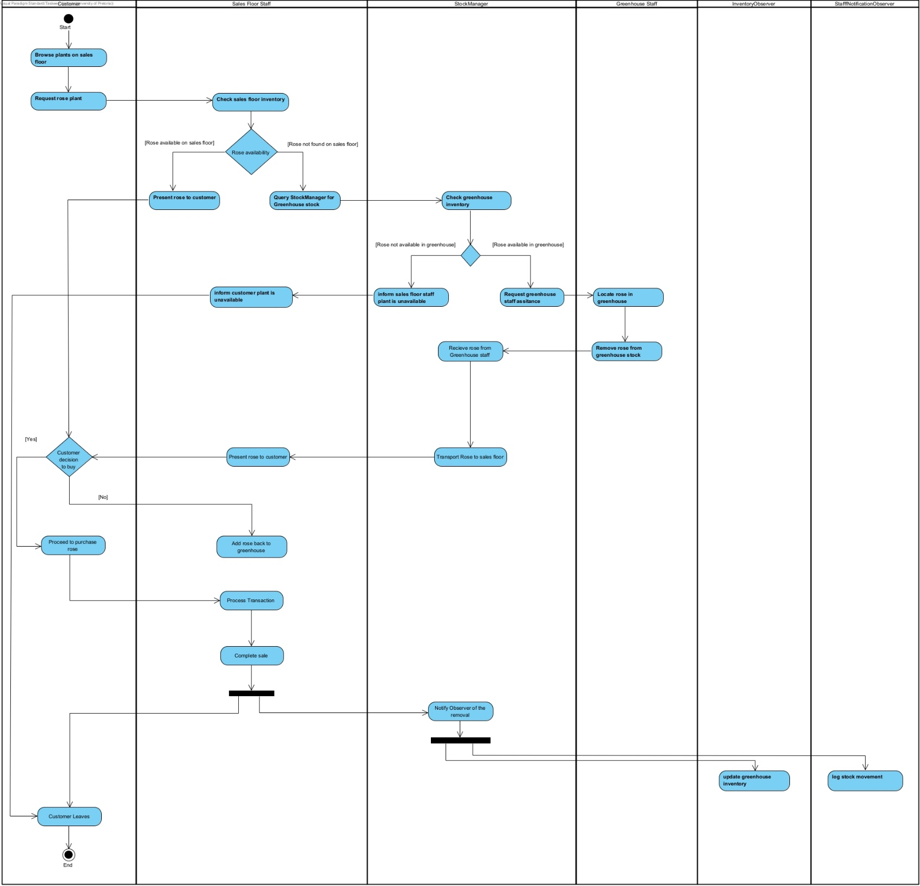
Activity Diagram

Slide 11

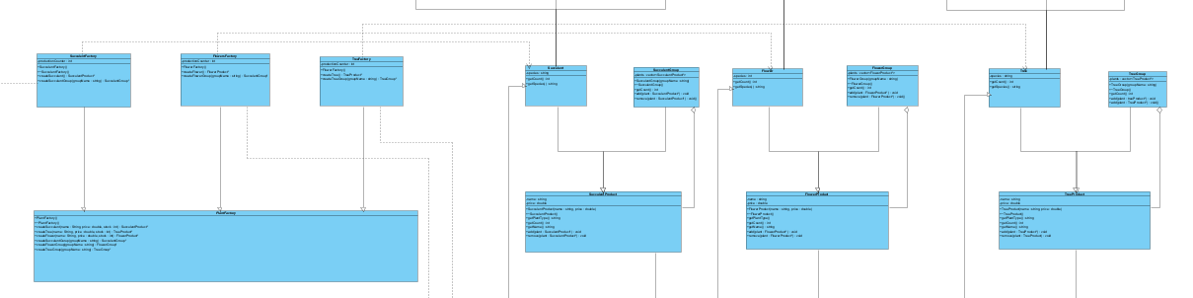
Pattern 1: Factory Method (Greenhouse/ Garden Area)
Participants: Creator – PlantFactory.
ConcreteCreators – SucculentFactory, FlowerFactory, TreeFactory.
Products – SucculentProducts, FlowerProducts, TreeProducts.
ConcreteProducts – Succulent, Flower, Tree.

Slide 12
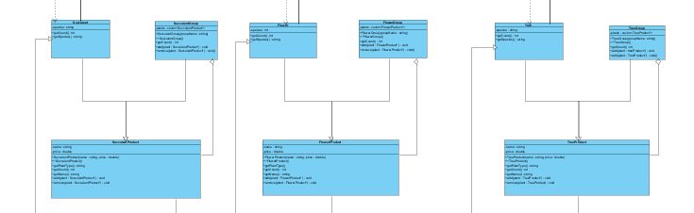
Pattern 2: Composite
3 instances of the composite pattern Participants:
Components – SucculentProduct, FlowerProduct, TreeProduct.
Composites – SucclentGroup, FlowerGroup, TreeGroup.
Leaves – Succulent, Flower, Tree.

Slide 13
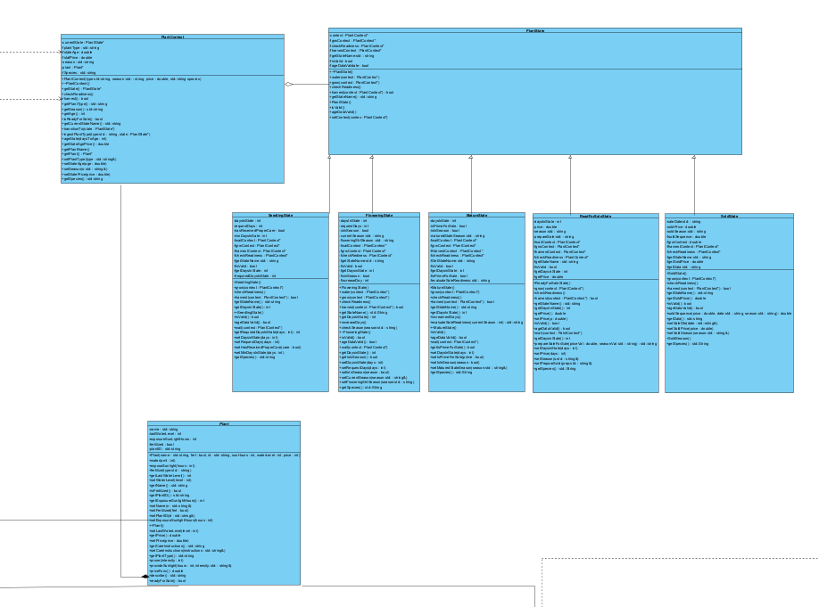
Pattern 3: State
Participants: State - PlantState
Context – PlantContext
ConcreteState – SeedlingState, FloweringState, MatureState, ReadyForSaleState,SoldState

Slide 14
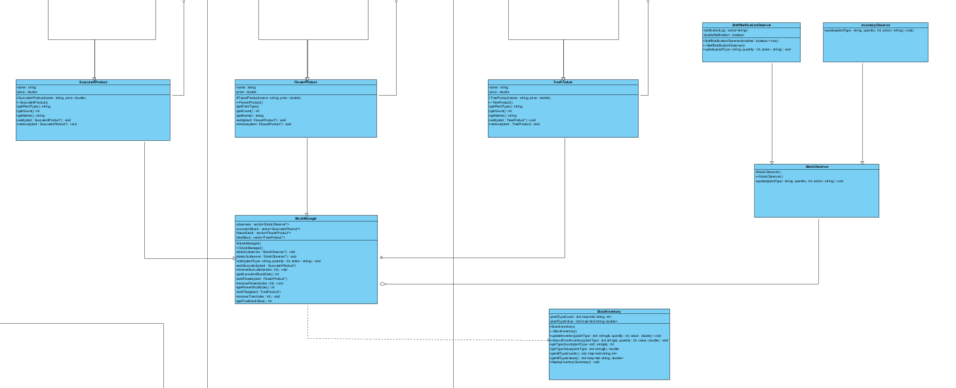
Pattern 4: Observer (Greenhouse/ Garden Area)
Participants: Subject – StockManager
ConcreteSubjects – SucculentProduct, FlowerProduct, TreeProduct.
Observer – StockObserver
ConcreteObservers – StaffNotificationObserver, InventoryObserver.

Slide 15
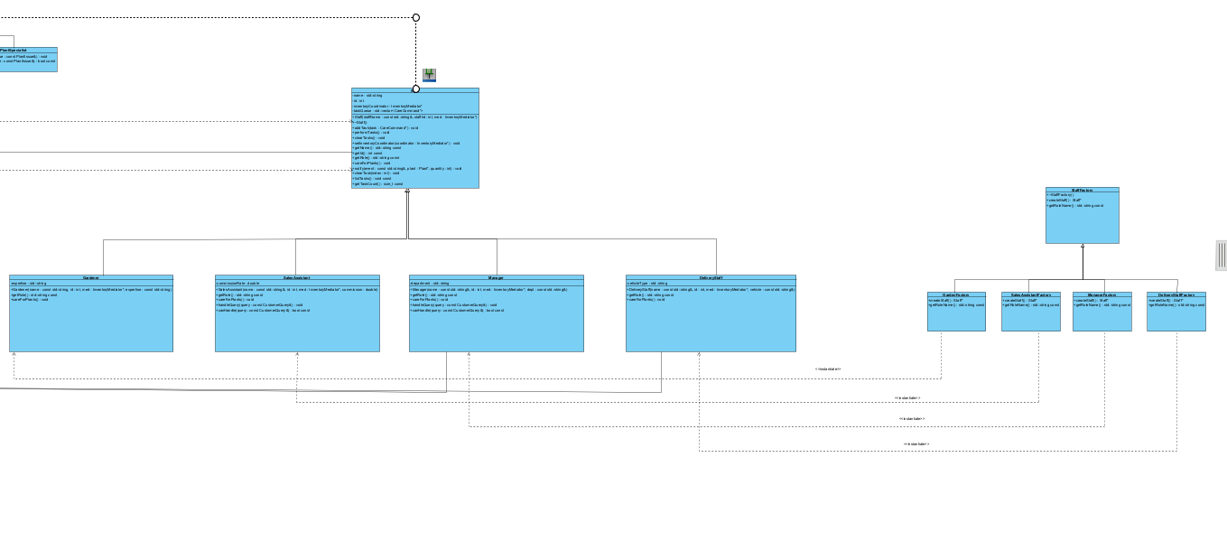
Pattern 1: Factory Method (Staff)
Participants:
Creator – StaffFactory
ConcreteCreator – GardenFactory,SalesAssistantFactory, ManagerFactory,DeliveryStaffFactory
Product –Staff
ConcreteProduct – Gardener,SalesAssistant,Manager,DeliveryStaff

Slide 16
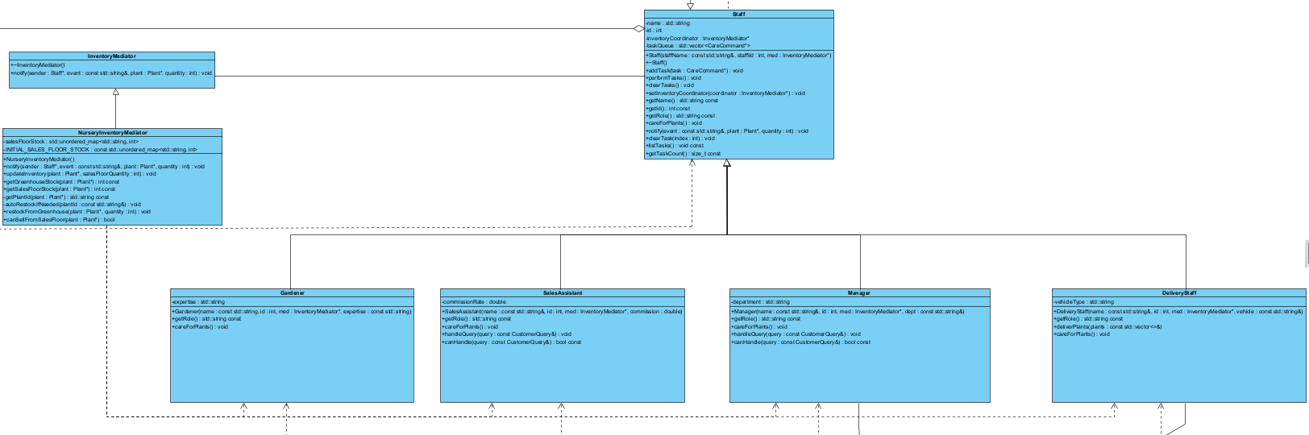
Pattern 5: Mediator
Participants:
Mediator- InventoryMediator
ConcreteMediator – NurseryInventoryMediator
Colleague- Staff
ConcreteColleague- Gardener, Manager, SalesAssistant, DeliveryStaff

Slide 17
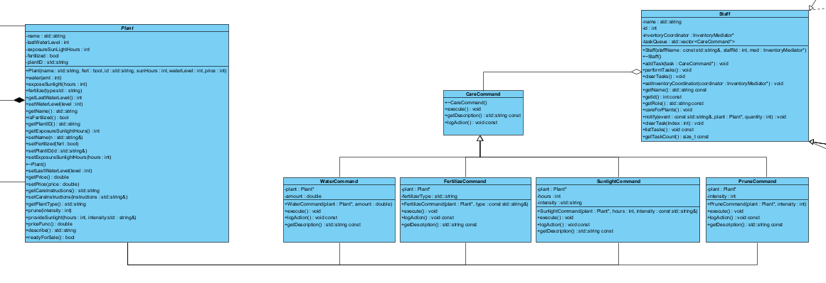
Pattern 6: Command (Staff)
Participants:
Command – CareCommand
ConcreteCommand- WaterCommand , FertilizeCommand , SunlightCommand, PruneCommand
Invoker – Staff
Receiver - Plant

Slide 18
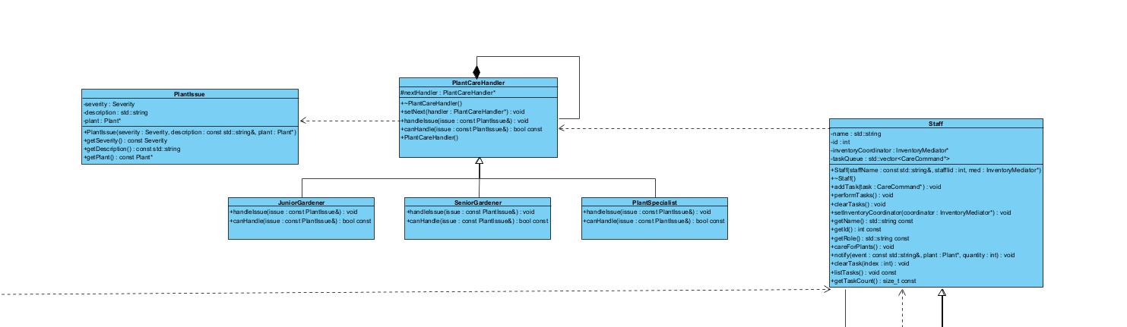
Pattern 7: Chain of Responsibility
Participants:
Handler – PlantCareHandler
ConcreteHandler – JuniorGardener,SeniorGardener,PlantSpecialist

Slide 19
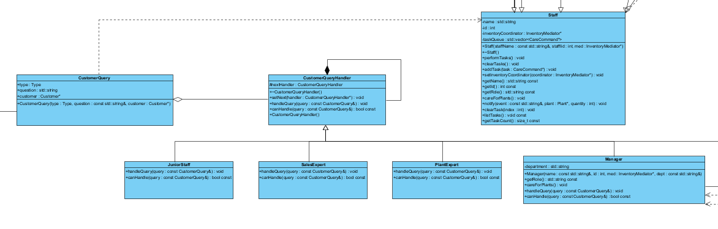
Pattern 7: Chain of Responsibility
Participants:
Handler – CustomerQueryHandler
ConcreteHandler – JuniorStaff, SalesExpert, PlantExpert, Manager

Slide 20
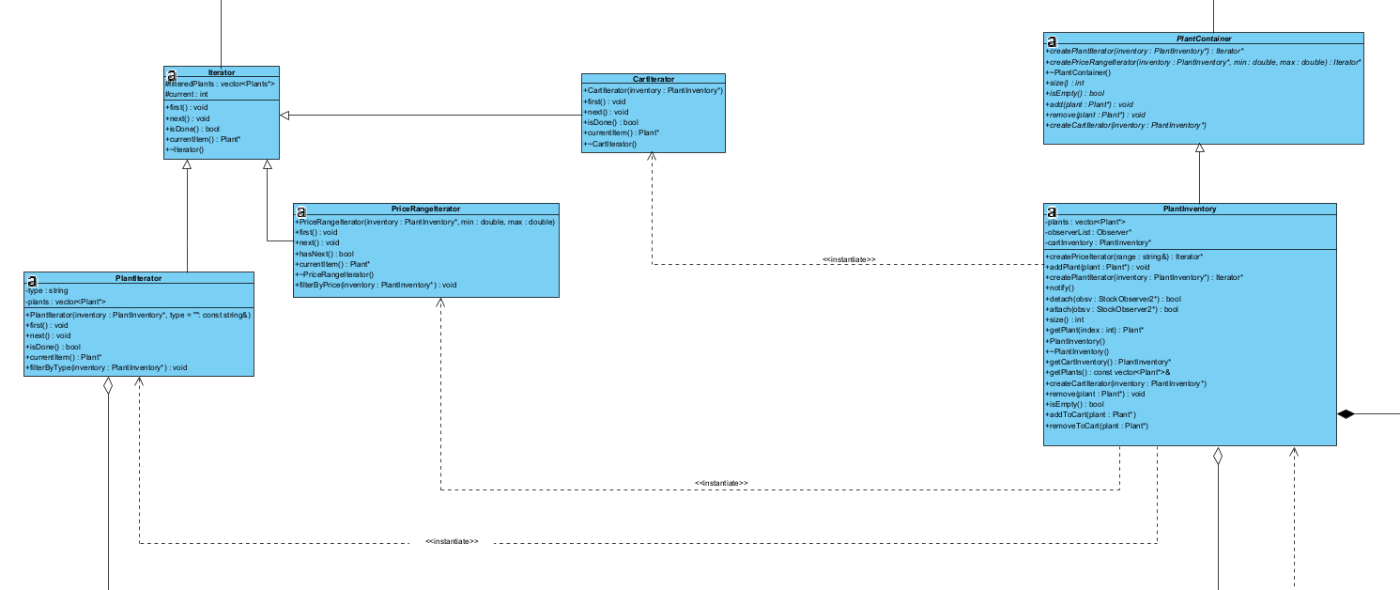
Pattern 8: Iterator
Participants:
Iterator – Iterator
ConcreteIterator – PlantIterator
Aggregate – PlantContainer
ConcreteAggregate - PlantInventory

Slide 21
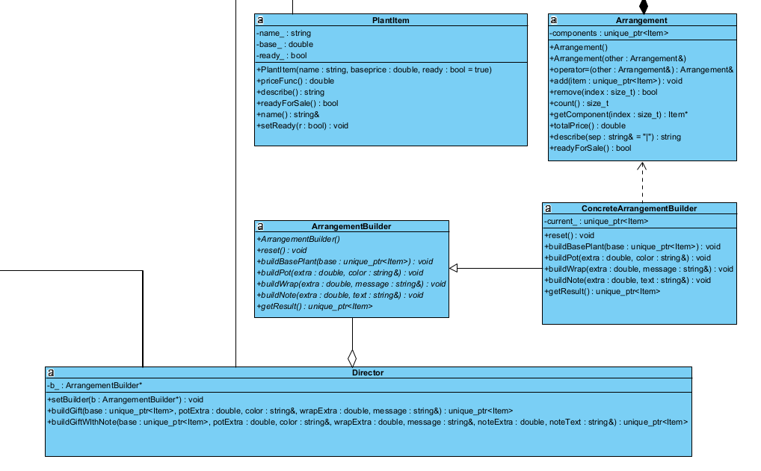
Pattern 9: Builder
Participants:
Director: Director
Builder: ArrangementBuilder
ConcreteBuilder: ConcreteArrangementBuilder
Product: Arrangement
The Builder pattern enables flexible, step-by-step creation of customizable arrangements. Director – Orchestrates the build process and enforces construction order. ArrangementBuilder – Defines abstract steps for creating arrangement parts. ConcreteArrangementBuilder – Implements the actual build logic (pots, wraps, notes). Product – The completed arrangement composed of decorated items.

Slide 22
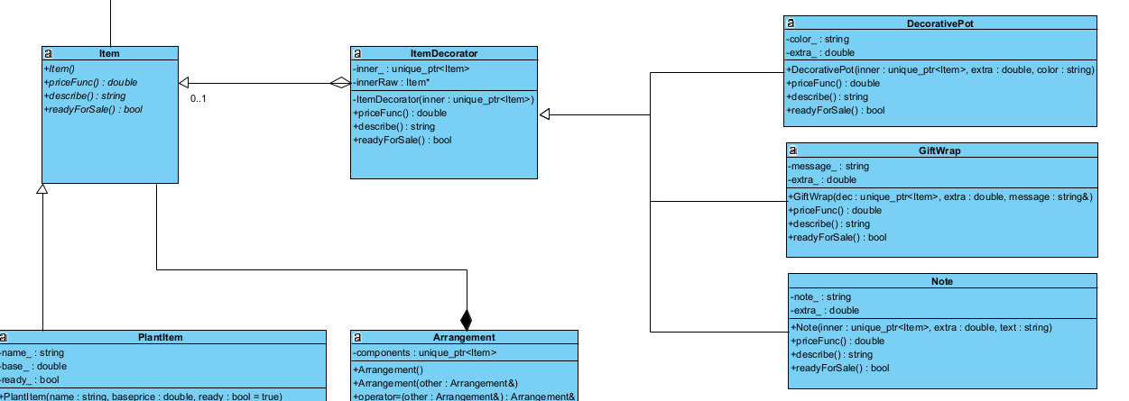
Pattern 10: Decorator
Participants:
Component – Item
ConcreteComponent – PlantItem
Decorator – ItemDecorator
ConcreteDecorator – DecorativePot, GiftWrap, Note
The Decorator pattern enables flexible, runtime layering of optional plant customizations (pots, wraps, notes) without subclassing. Each decoration wraps the base Item, keeping the system open for extension but closed for modification — ideal for modular personalization in the nursery system.

Slide 23
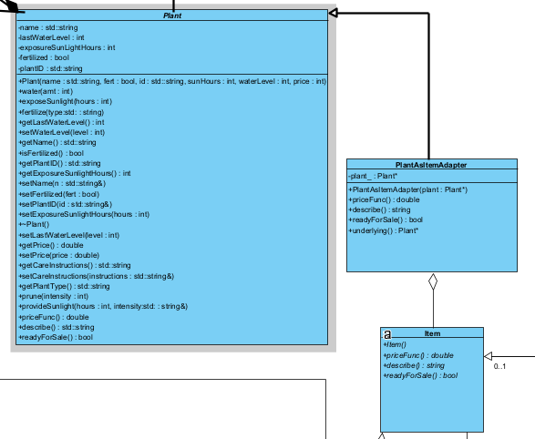
Pattern 11: Adapter
Participants:
Adaptee – Item
Target – Plant
Adapter - PlantAsItemAdapter
The Adapter pattern was used to unify two independent subsystems — plant management and sales personalization — by allowing Plant objects to behave like Items. It ensures compatibility without altering existing code, making it possible to decorate, bundle, and price plants using the same flexible pipeline as other store items. Other patterns were unsuitable because they would require modifying Plant’s hierarchy, breaking separation of concerns

Slide 24
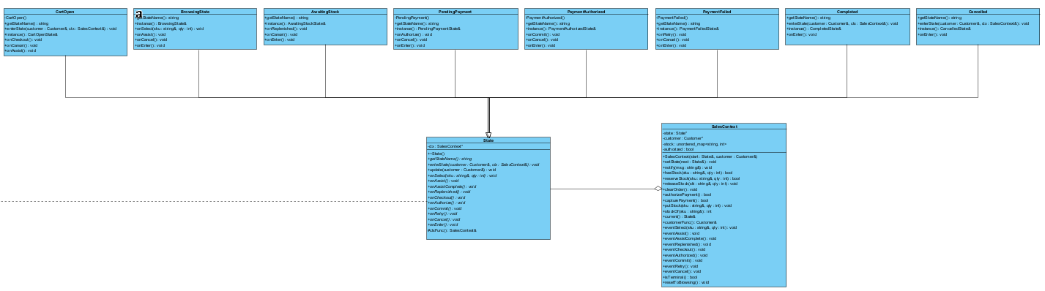
Pattern 3: State (Customers & Sales Floor)
Participants:
State – State
ConcreteStates- CartOpen,BrowsingState,AwaitingStock,PendingPayment,PaymentAuthorized,PaymentFailed,Completed,Cancelled
Context - SalesContext
We applied State to encode domain workflows whose behavior changes as status changes—specifically the Sales Order flow. Each state is a class that owns its valid transitions and actions eliminating sprawling if/else chains and preventing illegal operations at compile-time/runtime boundaries. This gives us clearer rules, easier unit tests, and pluggable extensions (new states or transitions) without touching existing logic.

Slide 25
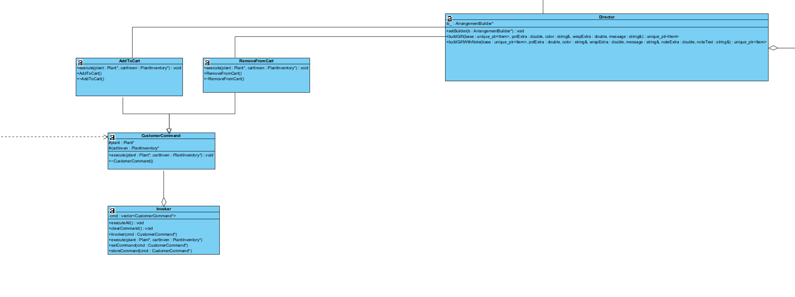
Pattern 6: Command (Customers & Sales Floor)
Participants:
Command – CustomerCommand
ConcreteCommand - AddToCart,RemoveFromCart
Invoker – Invoker
Receiver - Director

Slide 26
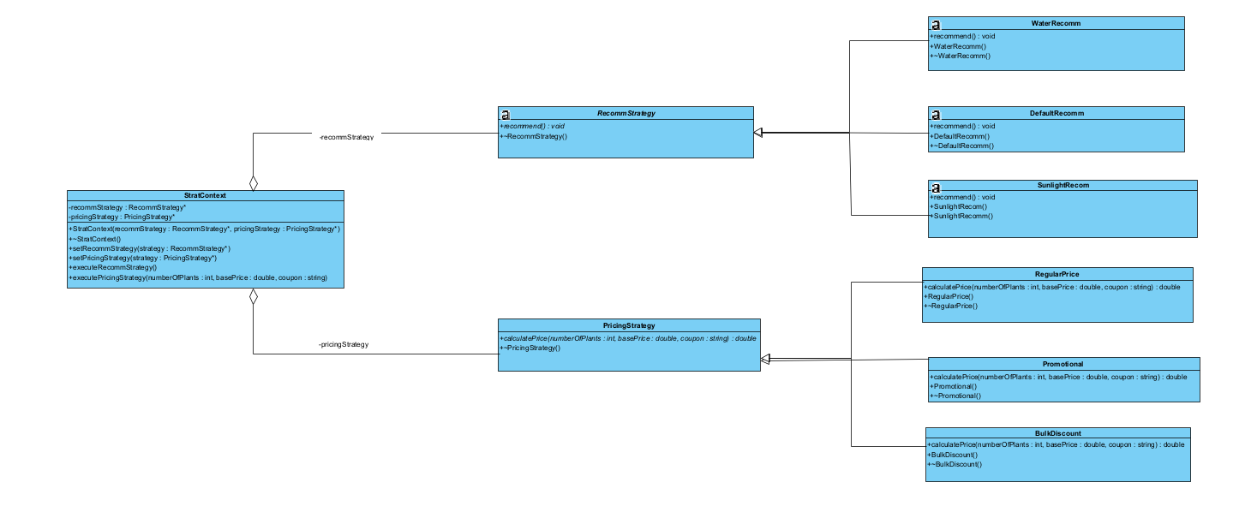
Pattern 12: Strategy
Participants:
Strategy – PricingStrategy,RecommStrategy
ConcreteStrategy- Promotional,BulkDiscount,RegularPrice,SunlightRecom,DefaultRecomm,WaterRecomm
Context –StratContext

Slide 27

Let’s Demo!

Slide 28
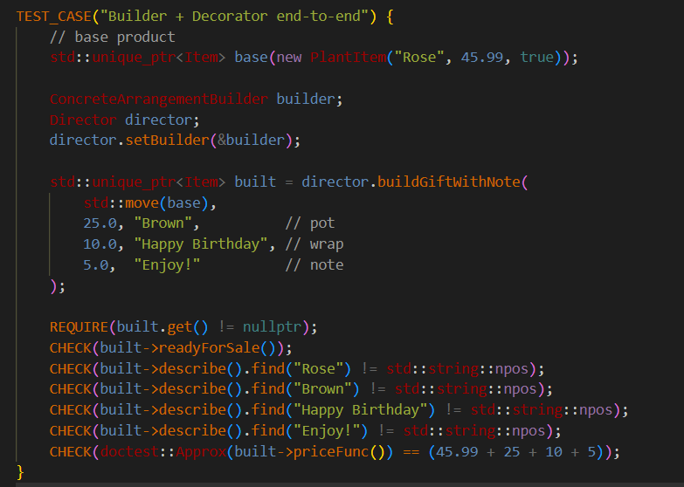
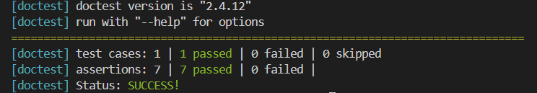
Doctest Unit Test: Personalization

Slide 29
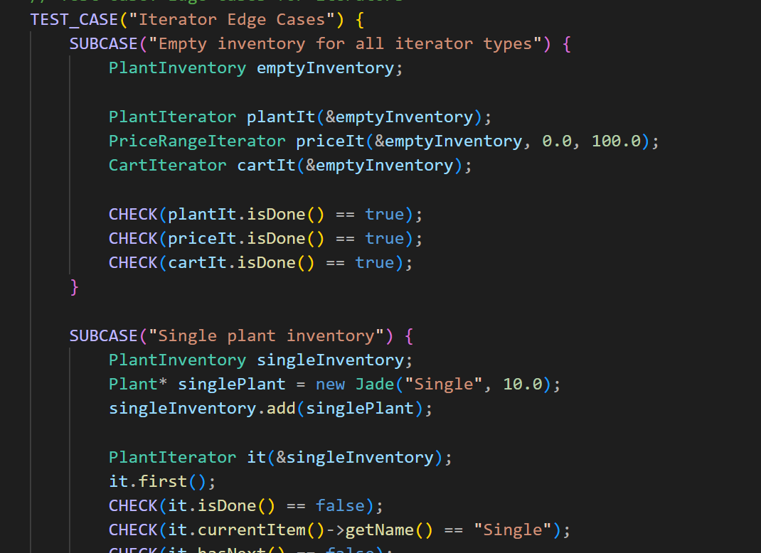
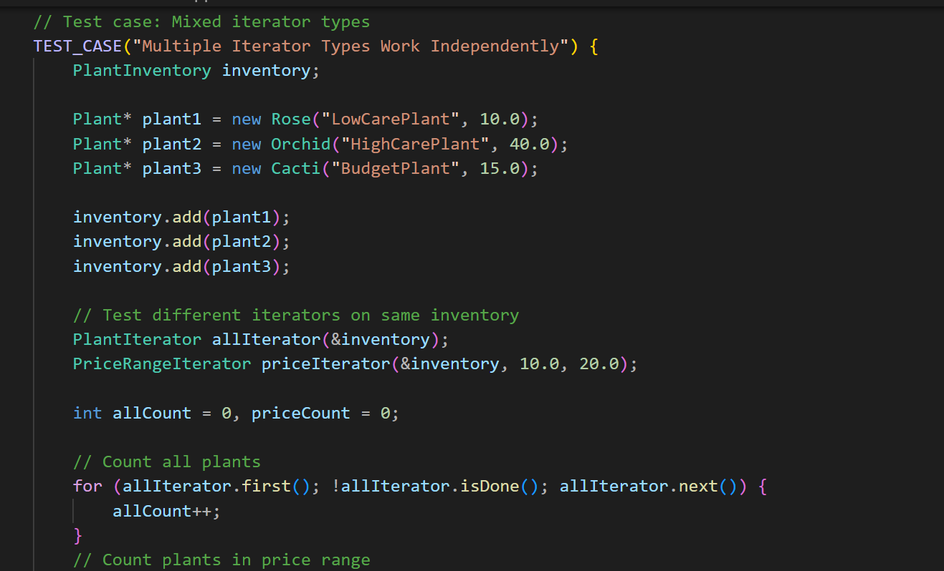
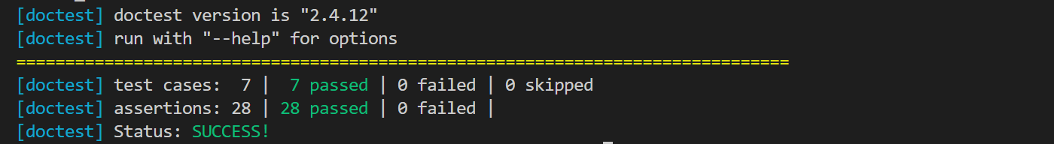
Doctest Unit Test: Sales Inventory

Slide 30
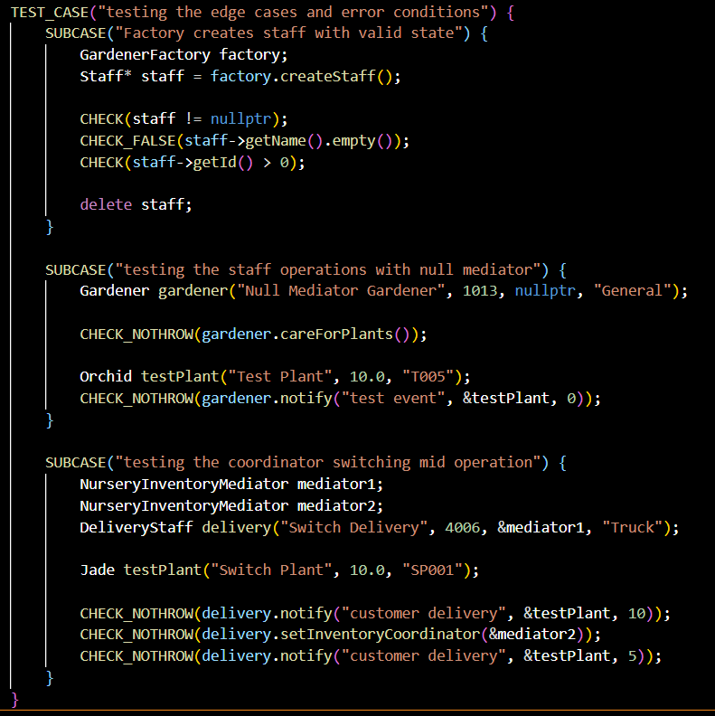
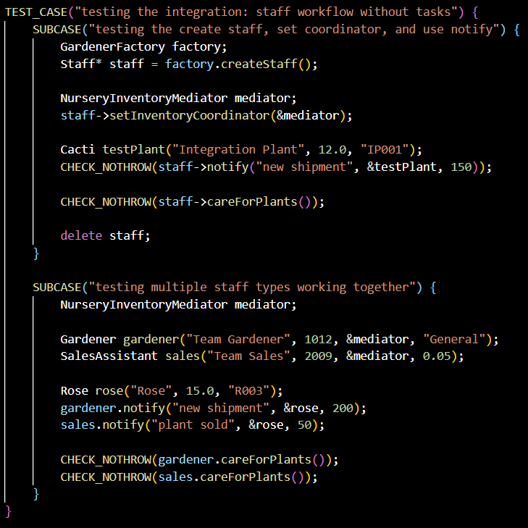
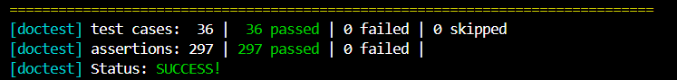
Doctest Unit Test: Staff

Slide 31
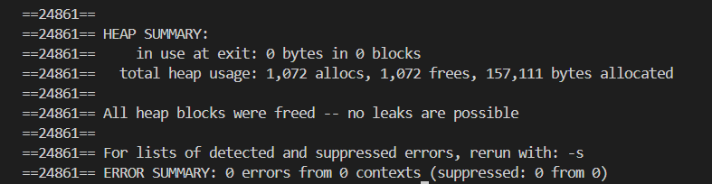
Memory Safety Testing Main

Slide 32

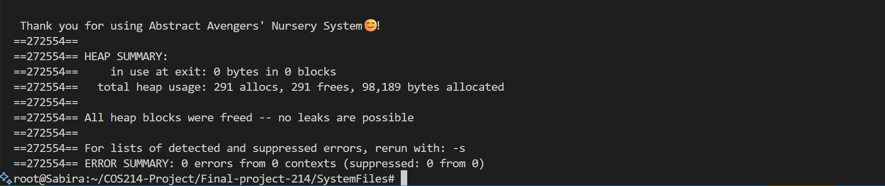
Memory Safety Demo Main

Slide 33
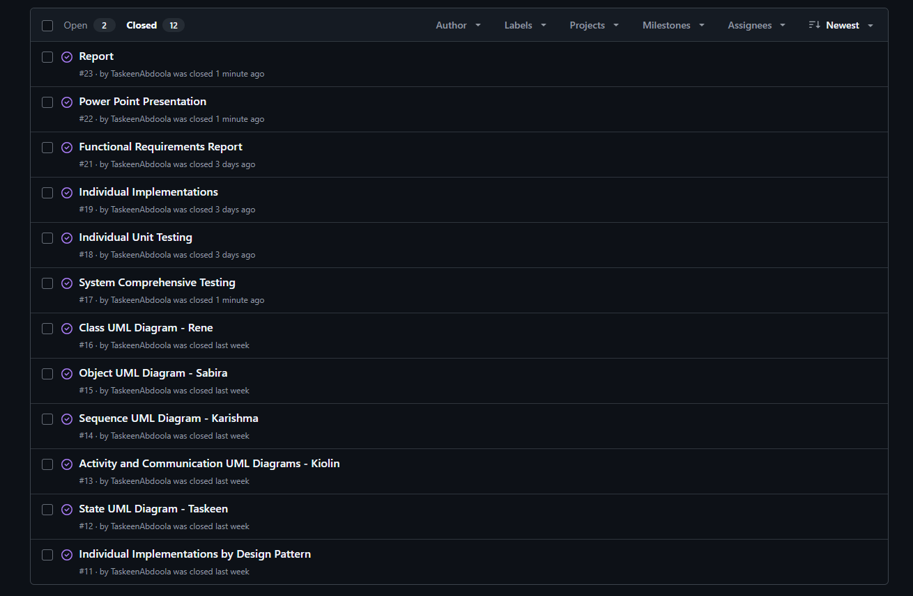
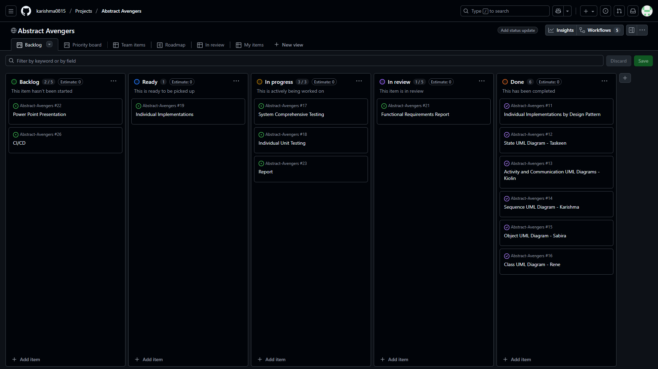
GitHub Actions: Project Management

Slide 34
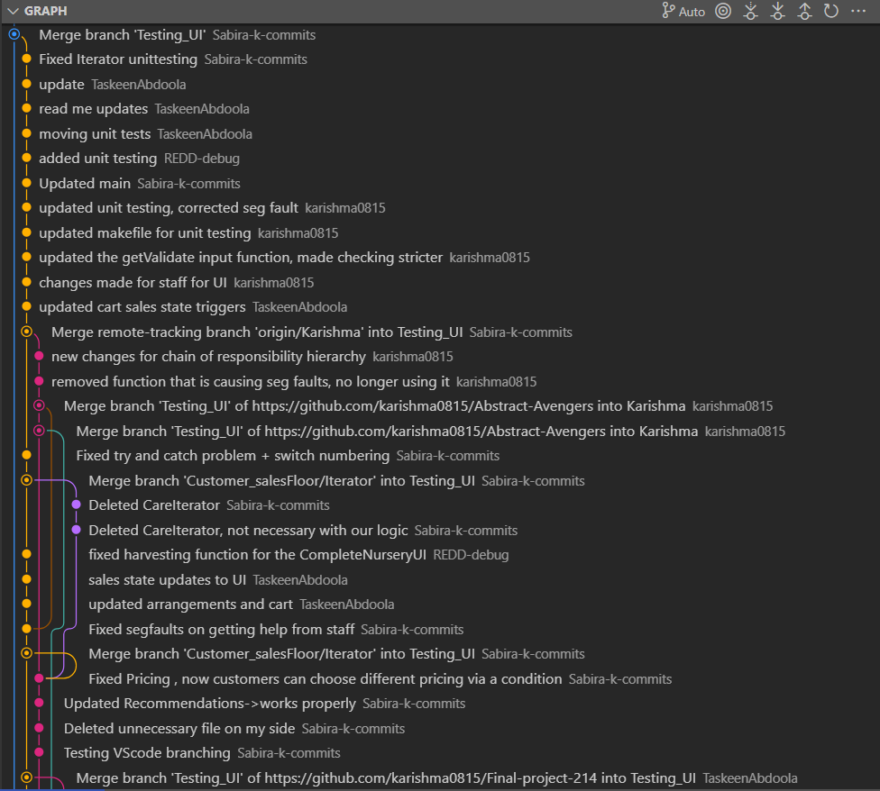
Flow Paradigm
We made use of the git flow paradigm
Individual branches were sourced created from main.
These branches were used by team members to implement their designs for the project
These branches were then merged into Testing_UI branch where the UI and demo main was tested
Finally, Testing_UI was merged into main

Slide 35
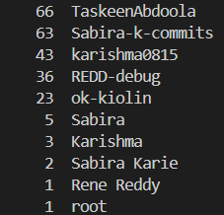
Commits
Run Command: git shortlog –sn
(Some usernames appear twice) Final totals: Taskeen Abdoola : 56 Sabira Karie : 50 Karishma Boodhoo : 35 Rene Reddy : 32 Kiolin Gounden : 19

Slide 36
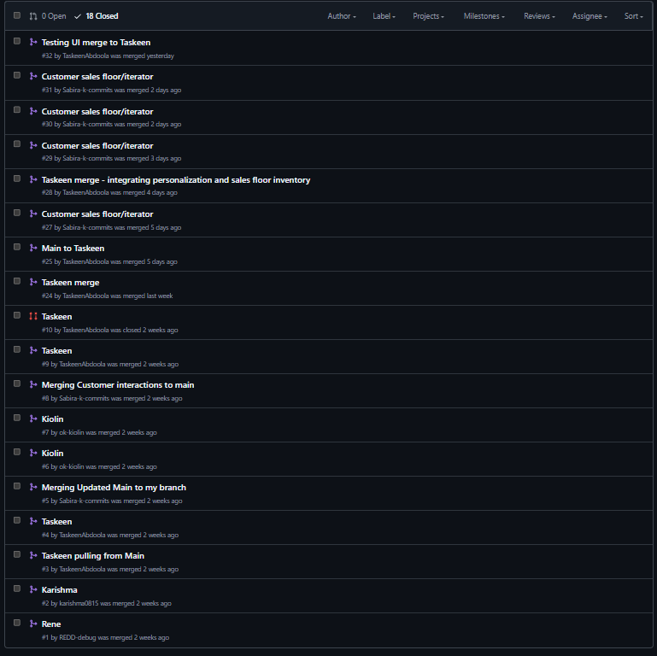
Pull Requests
Total Pull Requests

Slide 37
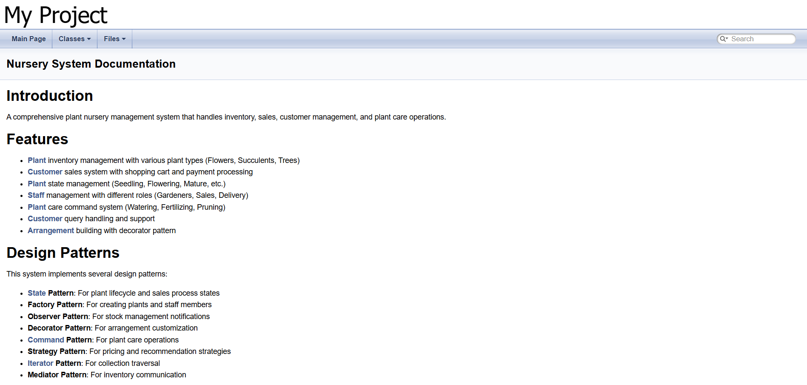
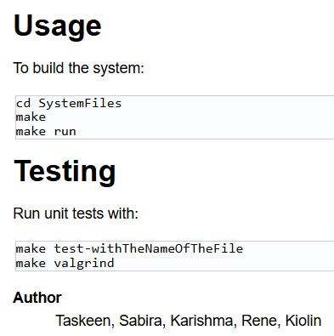
Doxygen

Slide 38
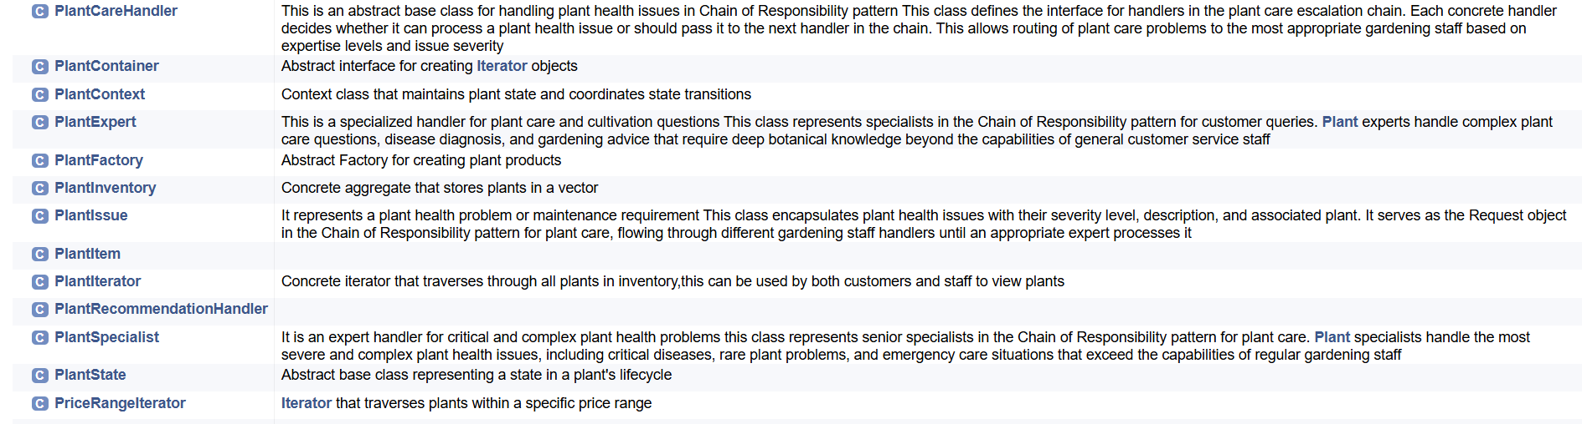
Doxygen

Slide 39
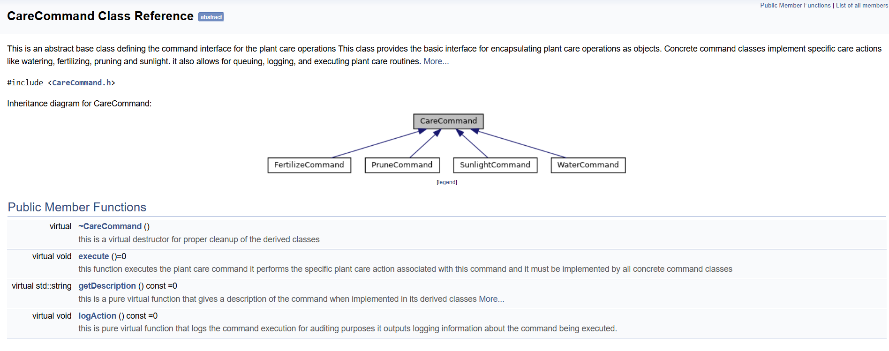
Doxygen

Slide 40
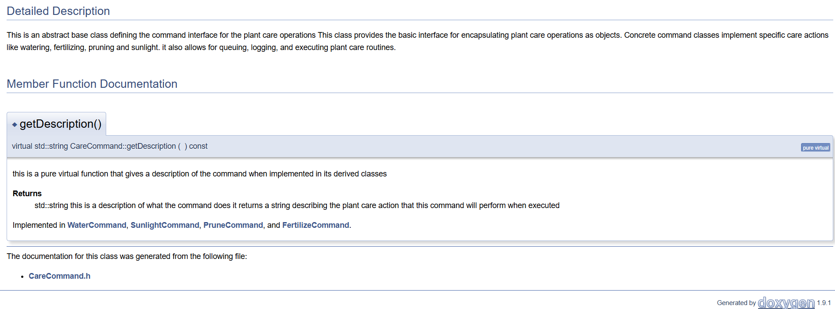
Doxygen

Slide 41

Questions, Comments & Concerns

